Slide 1

Dialog State Tracking Challenge II
Wencan Luo
12/06/2013
http://camdial.org/~mh521/dstc/

Slide 2
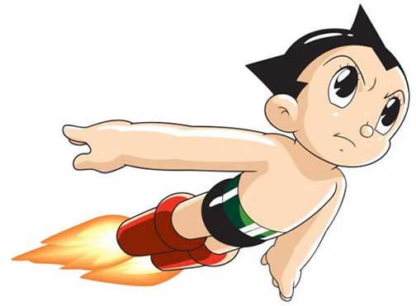
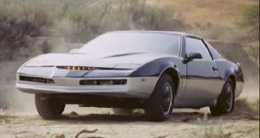
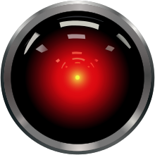
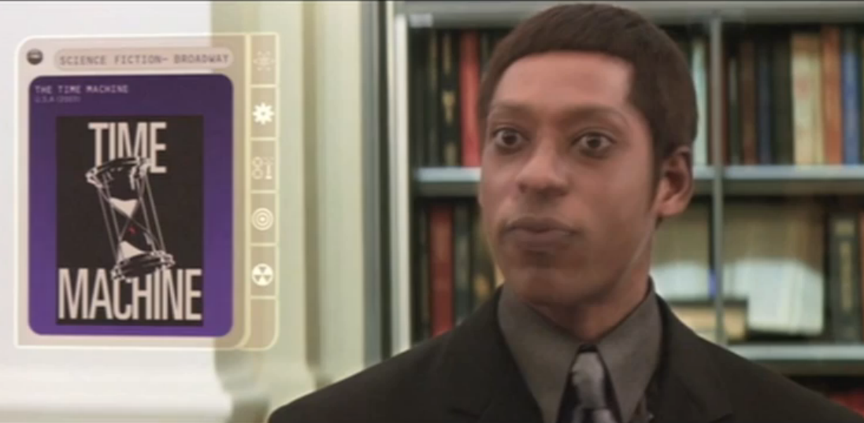
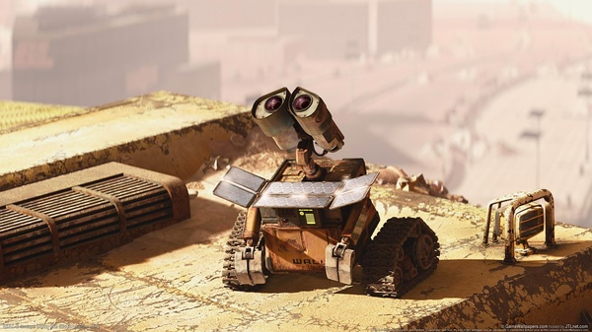
Motivation: Fiction
Astro Boy (1952)
KITT (Knight Rider) (1982)
HAL 9000 (2001)
Time Machine Librarian (2002)
WALL.E (2008)

Slide 3
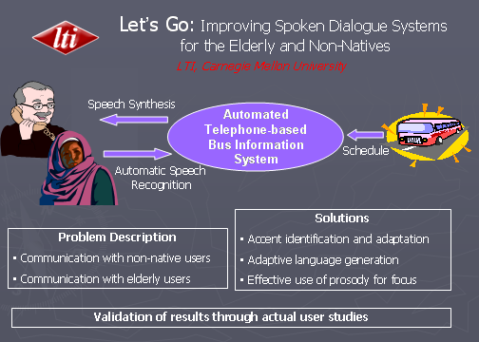
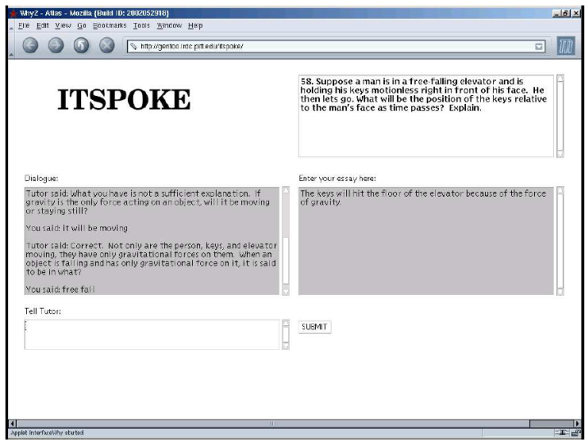
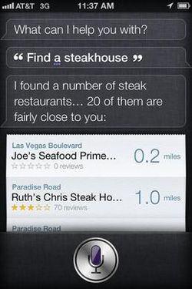
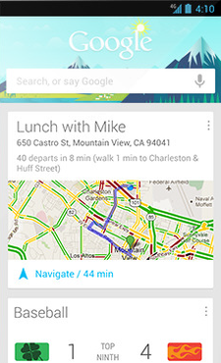
Motivation: from Fiction to Facts
2003
2004
2011
2012

Slide 4
Challenges: every transition is not perfect
ASR
Automatic Speech Recognizer
NLU
Natural Language Understanding
DM
Dialogue Manager
DM
Dialogue Manager
TM
Task Manager
NLG
Natural Language Generation
TTS
Text-to-Speech

Slide 5
Dialog State Tracking: from Open-loop to Close-loop
Dialog State Tracking
ASR
Automatic Speech Recognizer
NLU
Natural Language Understanding
DM
Dialogue Manager
DM
Dialogue Manager
TM
Task Manager
NLG
Natural Language Generation
TTS
Text-to-Speech

Slide 6
Dialog State Tracking Challenge (DST) Overview
Test Bank for comparing different approaches
Challenge 1 (finished)
Corpus: CMU, “Let’s Go” (Bus timetables)
9 teams, 27 submission
Results are in Sigdial 2013
No winer
Challenge 2 & 3
New Corpus: Restaurant

Slide 7
Schedule
7th October 2013 Train and development set released
20th January 2014 Unlabelled restaurant information test set released
27th January 2014 Tracker output on restaurant information test set due
3rd February 2014 Results on test set given to participants
5th March 2014 Approximate SIGdial deadline
June 2014 Results presented at SIGDIAL Conference

Slide 8
Corpus: An Example

Slide 9
Comprehensive Log Data

Slide 10
3 Dialog States

Slide 11
Accumulated Annotation

Slide 12
Task: Tracking the 3 States (an example output)

Slide 13
Evaluation Metrics

Slide 14
Basic Info about the Corpus

Slide 15
Our Current Approaches

Slide 16
Two baselines

Slide 17
Current Best Results

Slide 18
Other Interesting Results

Slide 19
Need your feedback!!

